Slide 1
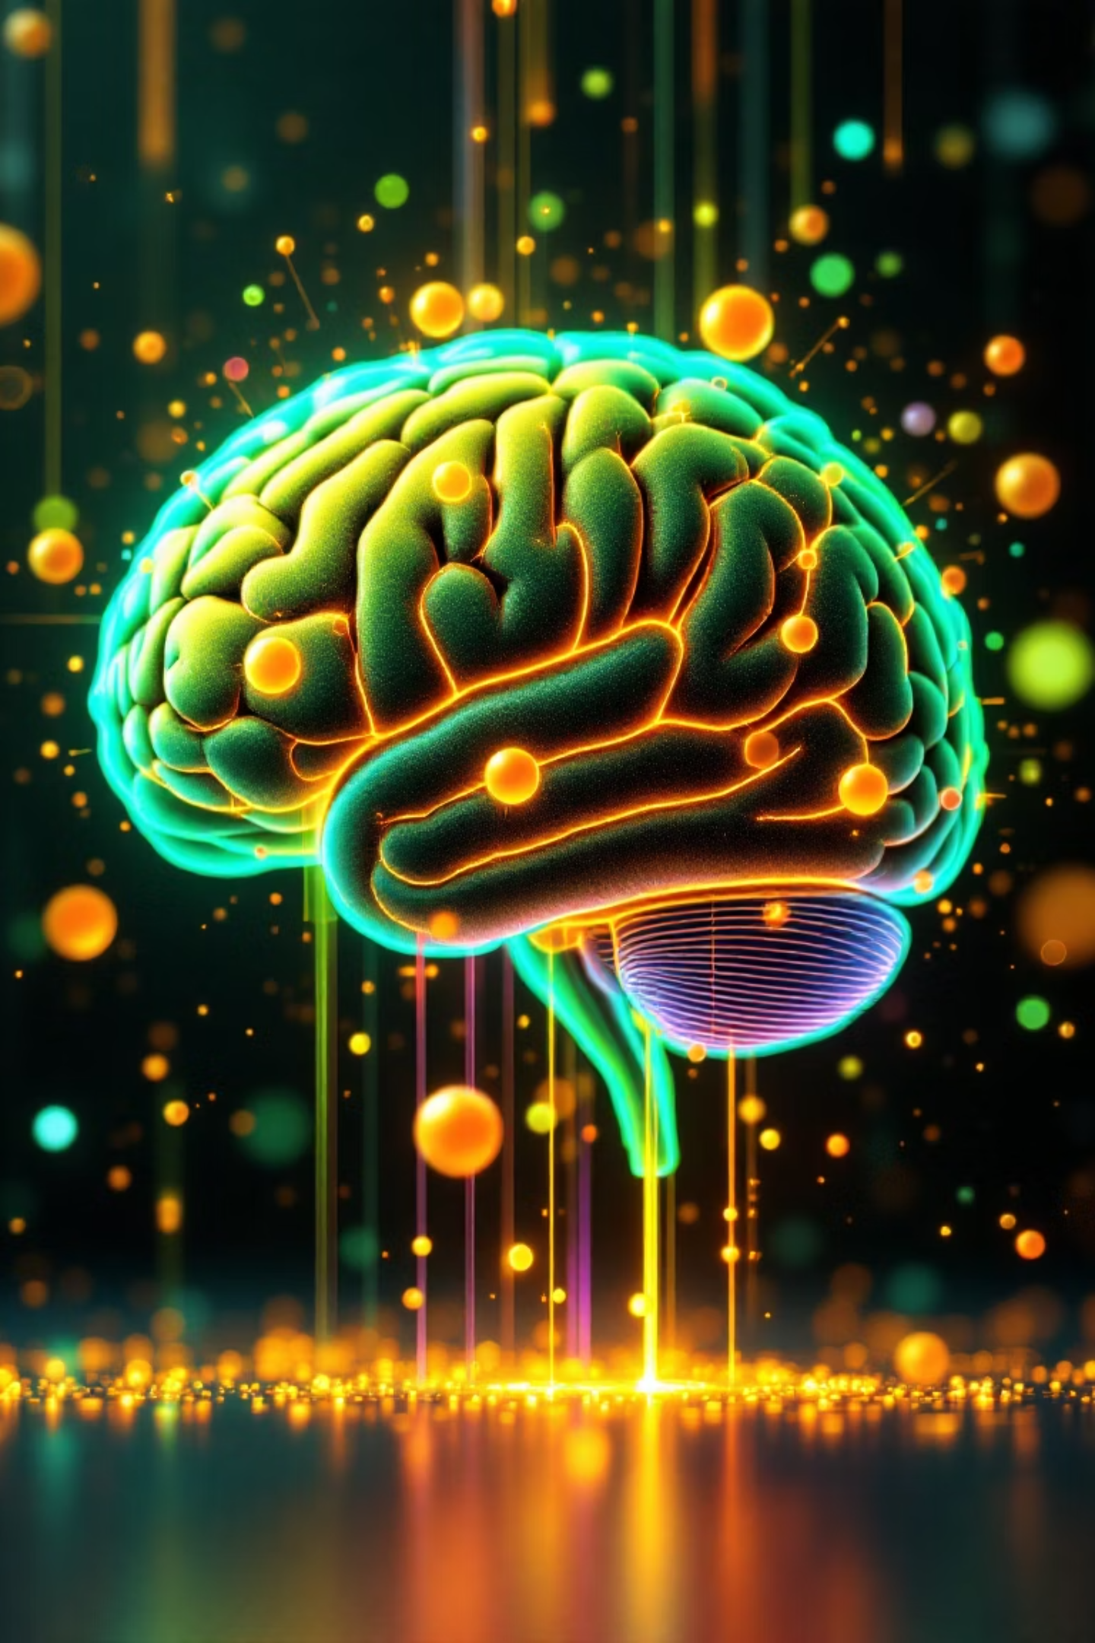
Unveiling Insights: An AI/ML Text Mining
Presented by Vignesh Mudaliyar
Date: January 05 2026

Slide 2
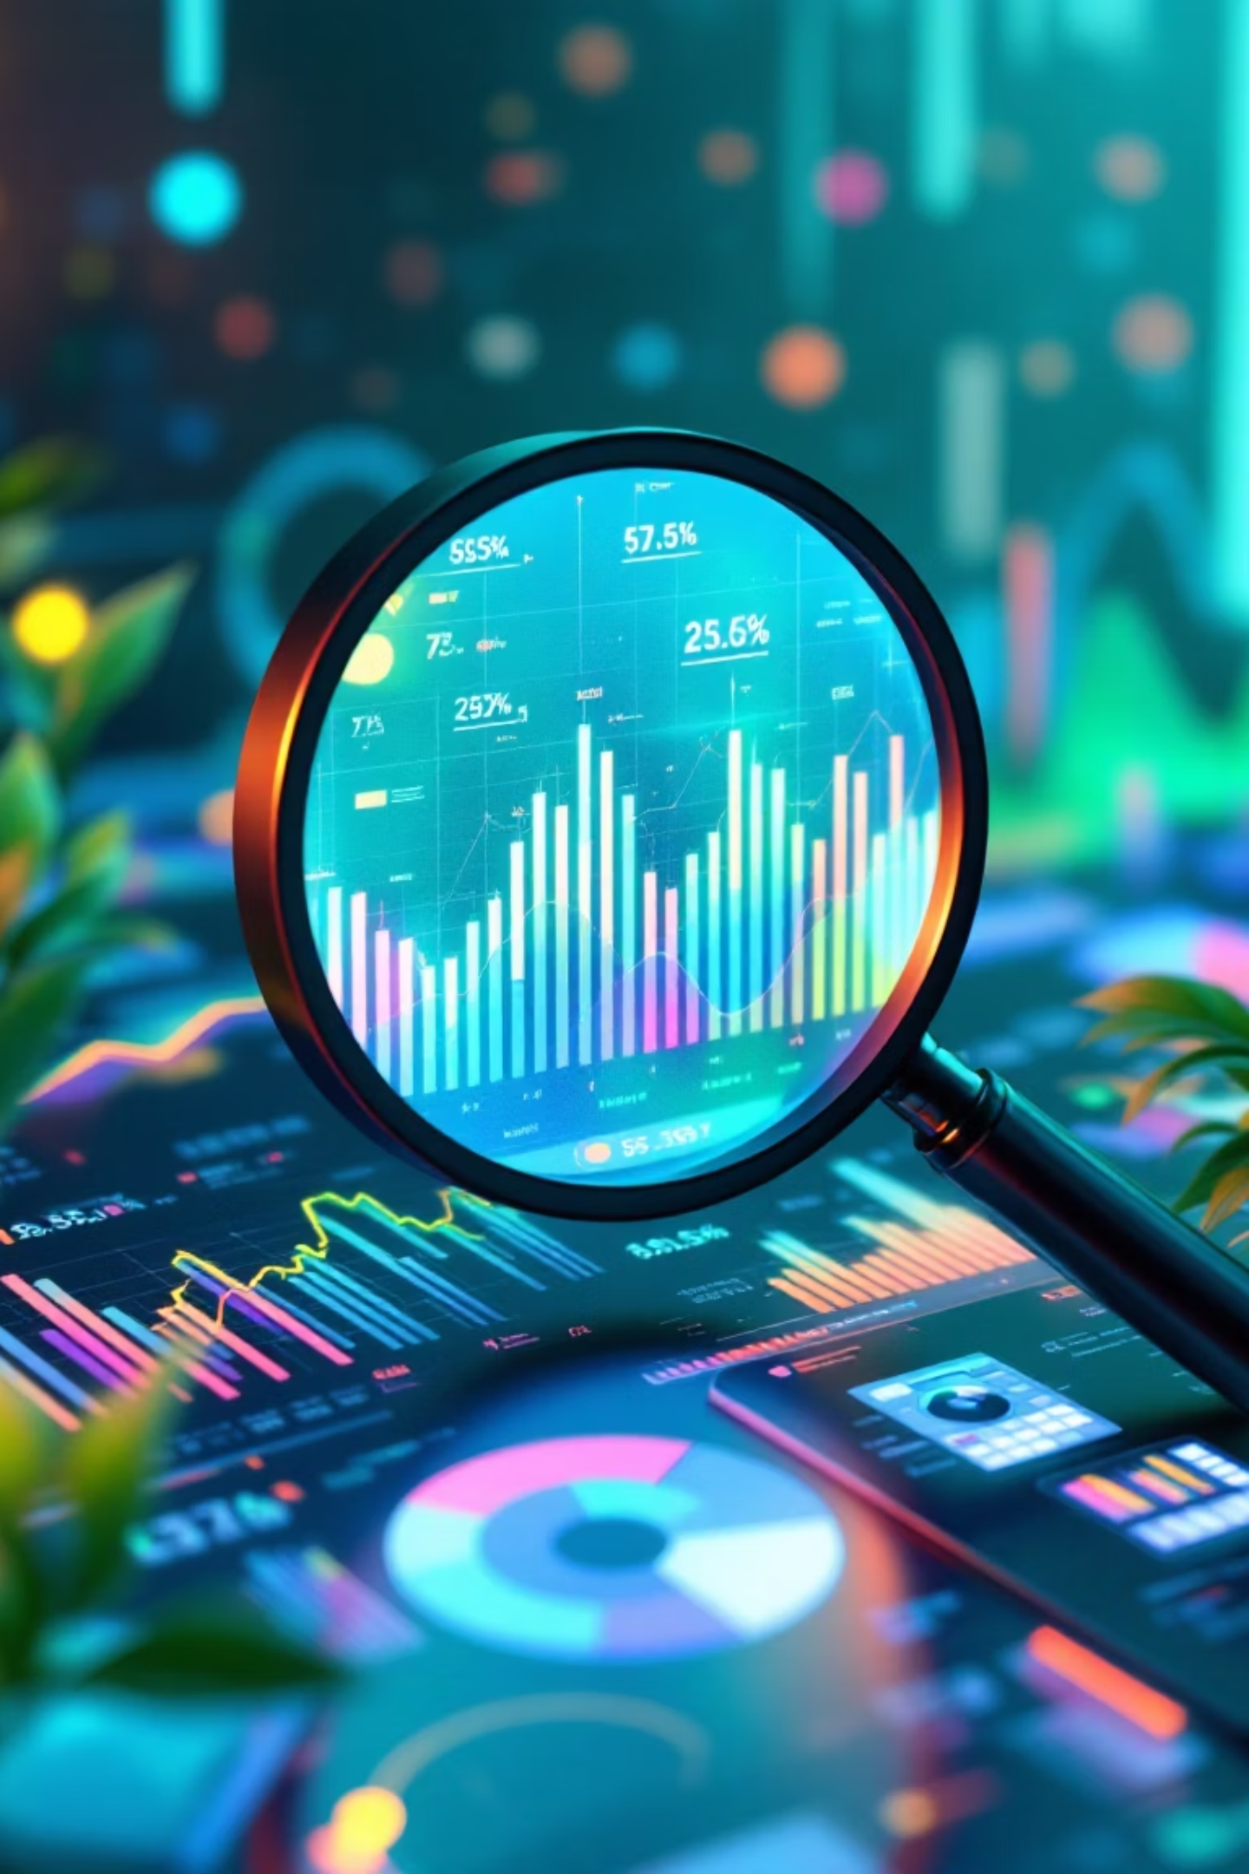
OBJECTIVE
Deconstructing Knowledge
Understand Core Concepts
Keyword Identification
Extracting foundational AI and Machine Learning principles.
Pinpointing critical terminology and emerging themes.
Frequency Analysis
Quantifying the prevalence of key terms and phrases.

Slide 3
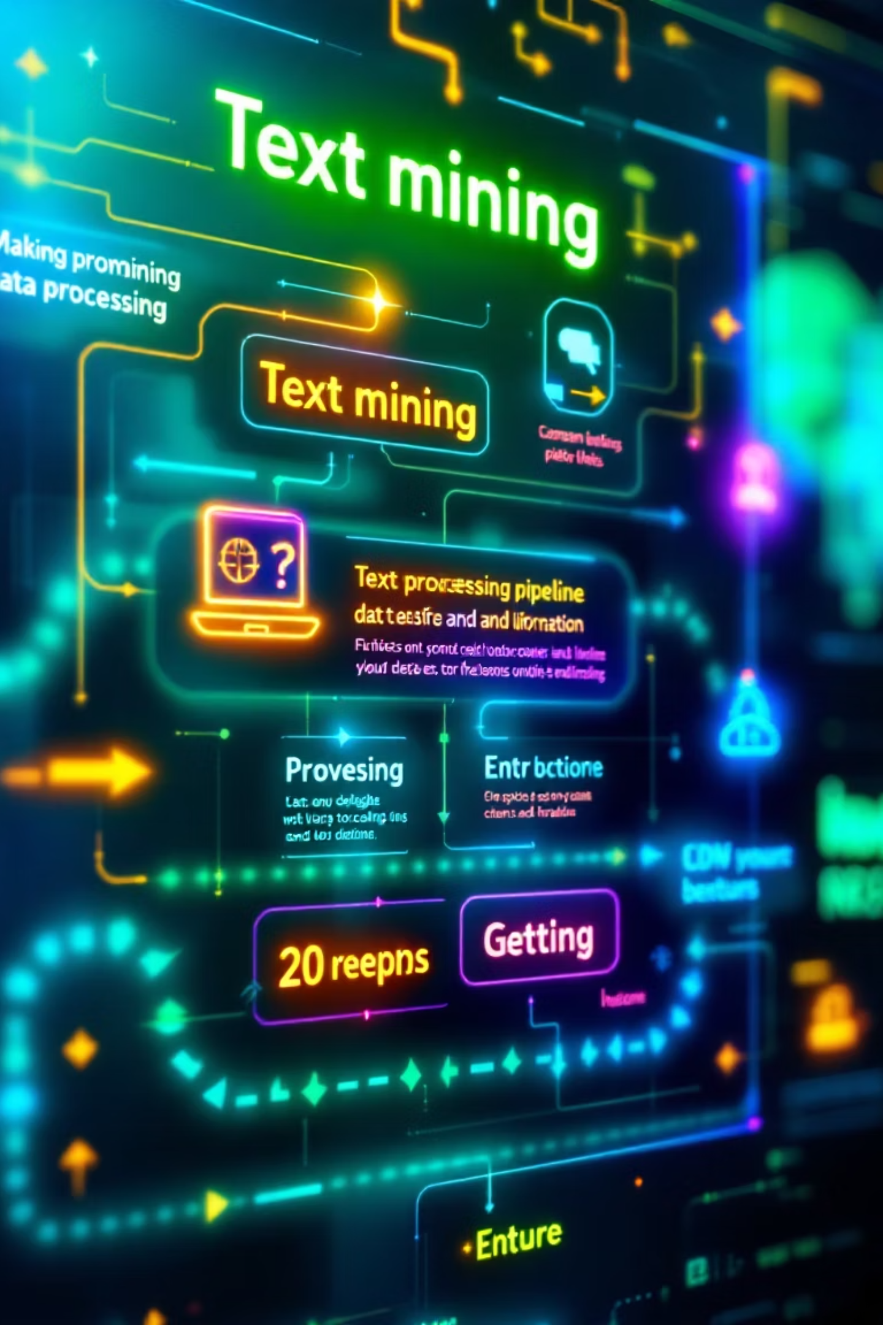



METHODOLOGY
Systematic Text Mining Workflow
Text Cleaning
Removing noise, special characters, and irrelevant information.
Tokenization
Breaking down text into individual words or units.
Stopword Removal
Eliminating common, uninformative words (e.g., "the," "is").
N-gram Analysis
Identifying sequences of words (bigrams, trigrams) for contextual understanding.

Slide 4
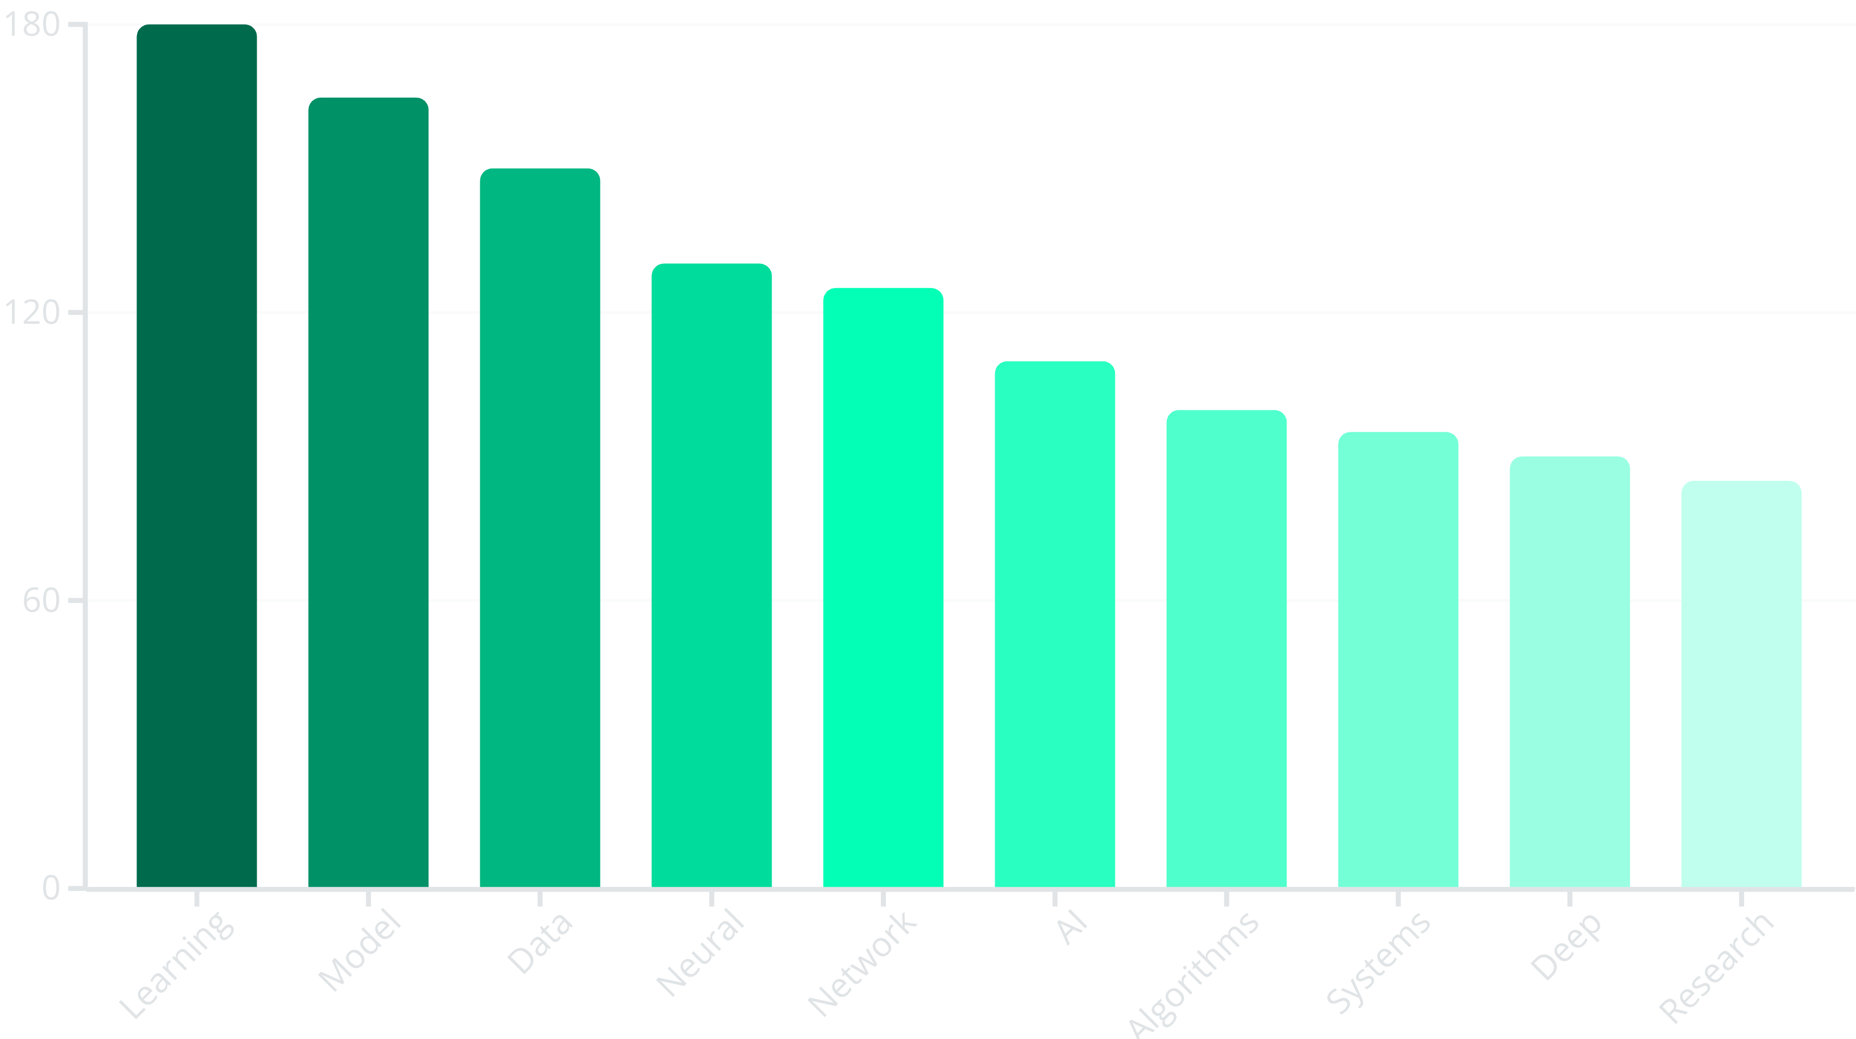
ANALYSIS
Word Frequency Insights
Identifying the most prominent individual terms within the document.

Slide 5
ANALYSIS
Bigrams: Connecting Concepts
Top 10 two-word phrases revealing common conceptual pairings.
Neural Network
Machine Learning
Deep Learning
Data Science
Artificial Intelligence
Computer Vision
Large Scale
Predictive Models
Natural Language
Processing Algorithms

Slide 6
ANALYSIS
Trigrams: Contextual Depth
Top 10 three-word phrases offering richer contextual understanding.
Deep Neural Networks
Machine Learning Models
Natural Language Processing
Artificial Intelligence Systems
Computer Vision Tasks

Slide 7
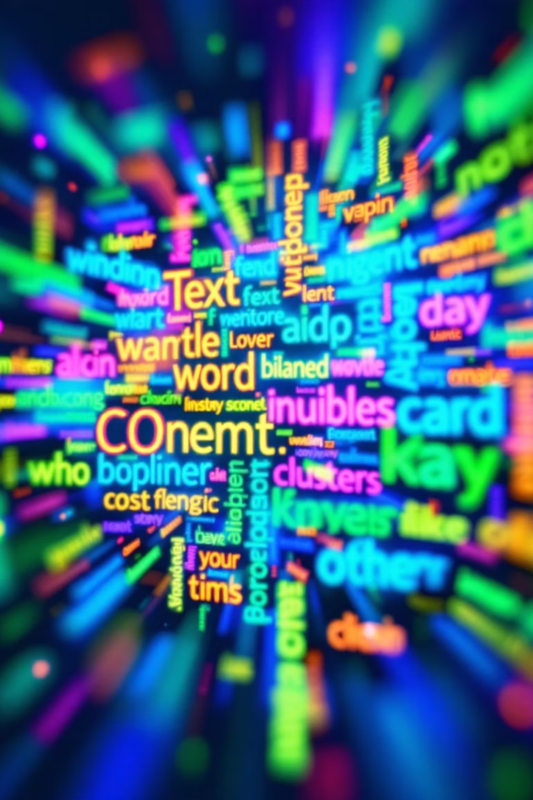

VISUAL SUMMARY
Word Cloud: A Panoramic View
The word cloud visually emphasizes the most recurring themes: Learning, Model, Data, Neural, Network, and AI.
Larger font sizes indicate higher frequency and significance within the document.

Slide 8


KEY DISCOVERIES
Unlocking Core Insights
Dominant Concepts
Recurring Terminology
Key Phrases
Focus on "Deep Learning," "Neural Networks," and "Machine Learning" as central pillars.
"Data," "Models," and "Algorithms" are fundamental to the discussed methodologies.
Strong emphasis on "Natural Language Processing" and "Computer Vision" applications.

Slide 9

OUTLOOK
Conclusion & Future Directions
Summary of Findings
Future Work
Comprehensive overview of AI/ML landscape.
1
Identified key technologies and their interconnections.
Established foundational vocabulary for further research.
Predictive Analysis
Applying models to forecast trends and outcomes.
2
Automated Summarization
Developing systems for concise document condensation.
3
Sentiment Analysis
Extracting emotional tone from textual data.

